Slide 1

FAKE NEWS DETECTION
Rachata Kaewviset
6410406843

Slide 2


Goals
FAKE

Slide 3
Logistic Regression
because it can estimate the likelihood of a given text being either real or fake news. It's especially useful for analyzing text data, performs well in binary classification tasks

Slide 4
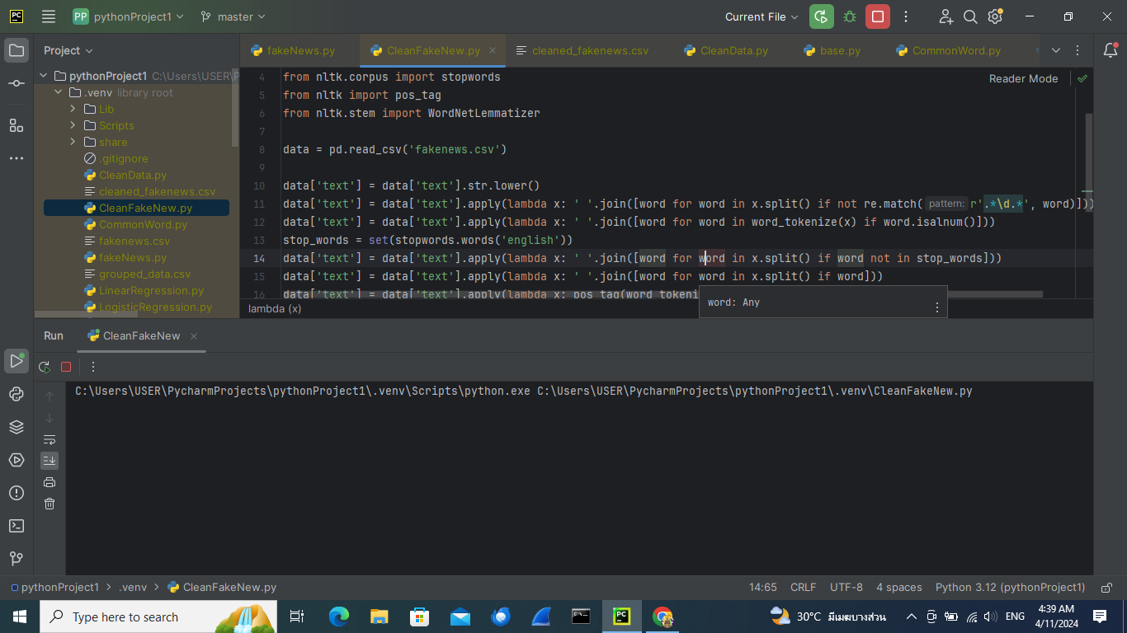

Text Cleansing
1.Lower case all text
Get
get

Slide 5
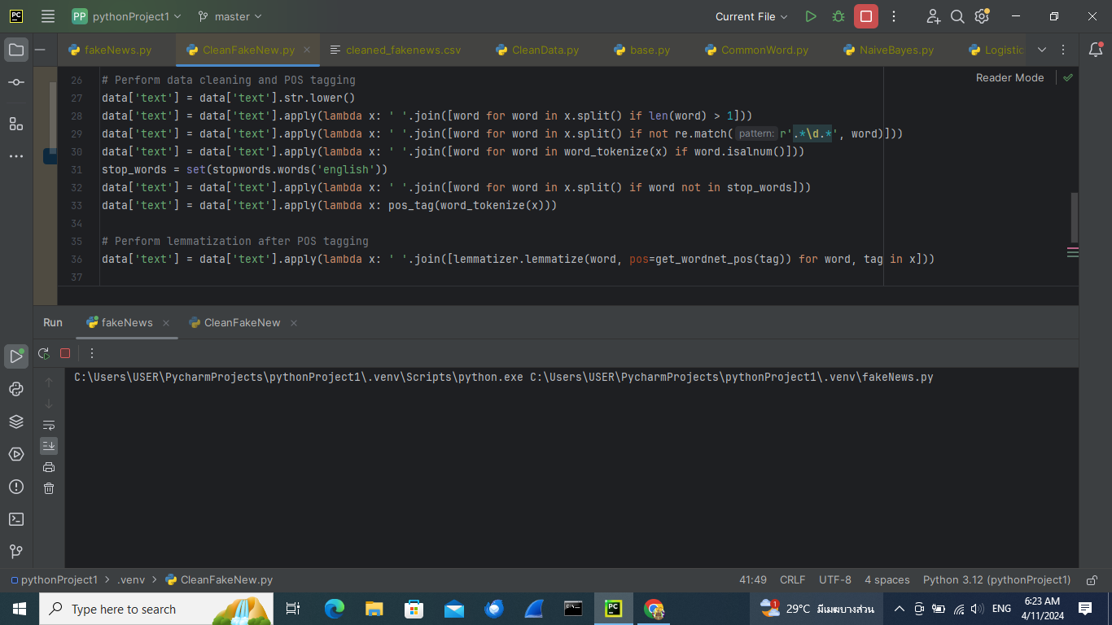
Text Cleansing
2.Removing words with only one letter
A

Slide 6
Text Cleansing
3.Remove words that contain numbers
25th

Slide 7
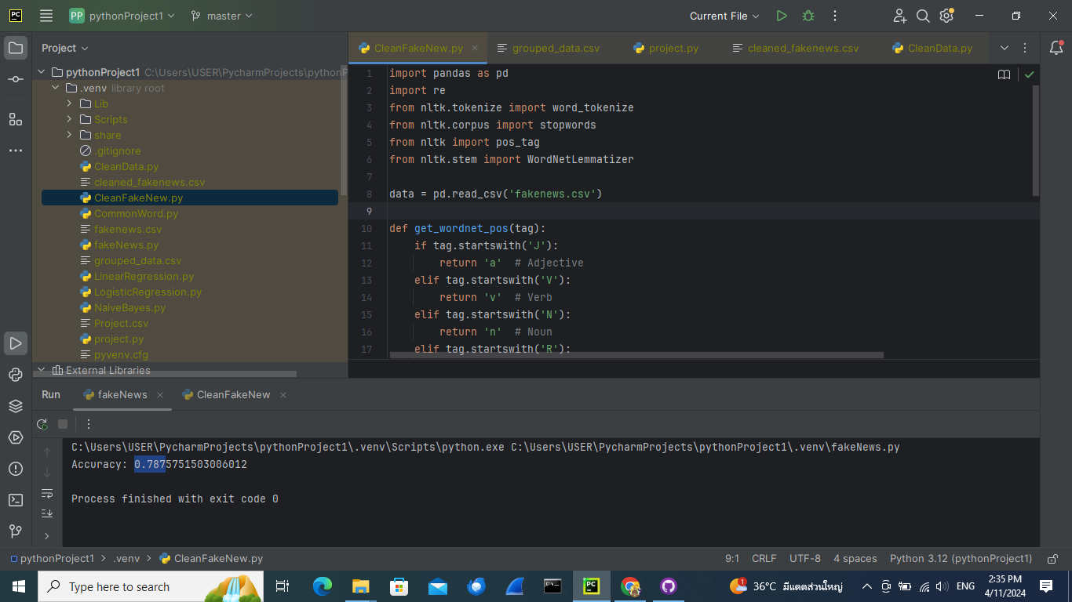
Text Cleansing
4.Tokenizing the text ,Remove empty tokens and removing punctuation
"get
get

Slide 8
Text Cleansing
5.Remove all stop words
latest from today
latest today

Slide 9
Text Cleansing
6.POS tagging the text
get latest today
('get', 'VB'), ('latest', 'JJS'), ('today', 'NN')

Slide 10
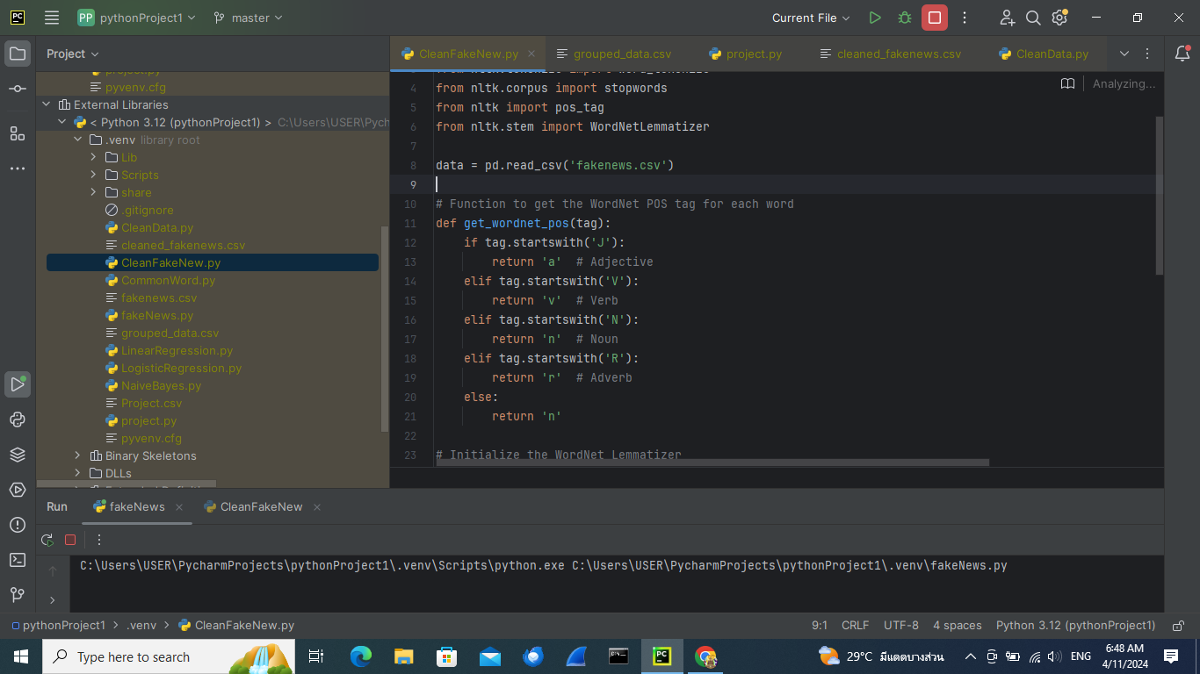
Text Cleansing
7.Lemmatizing the text
('get', 'VB'), ('latest', 'JJS'), ('today', 'NN')
get late today

Slide 11
Feature Extraction
TF-IDF vectorizer = TF(t,d) * IDF(t)
TF(t,d) = number of t appear in Document/all word in Document
IDF(t) = log [ (1 + n) / (1 + number of Document that appear t) ] + 1
texts
numbers

Slide 12
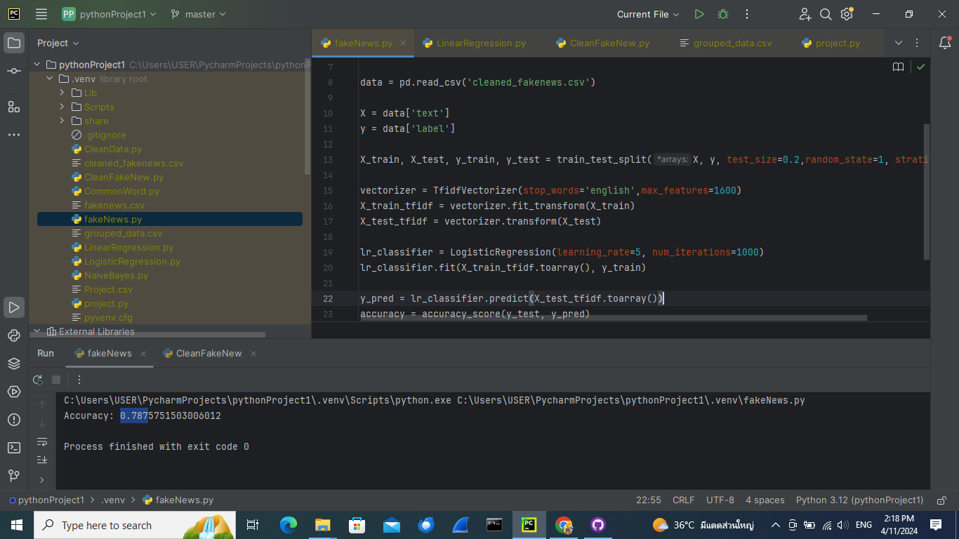
Feature Extraction
limit feature
some word are rarely to appear it might be consider as a noise
*use only top 1600 word that appear on document

Slide 13
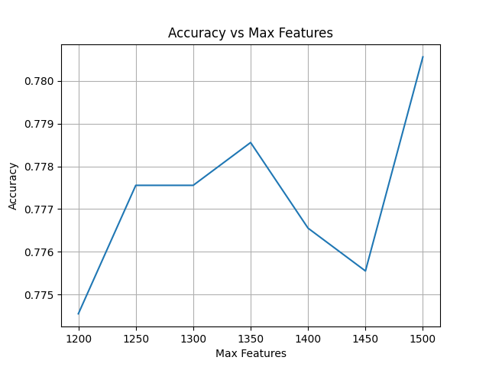
Tuning Parameter Max Features

Slide 14
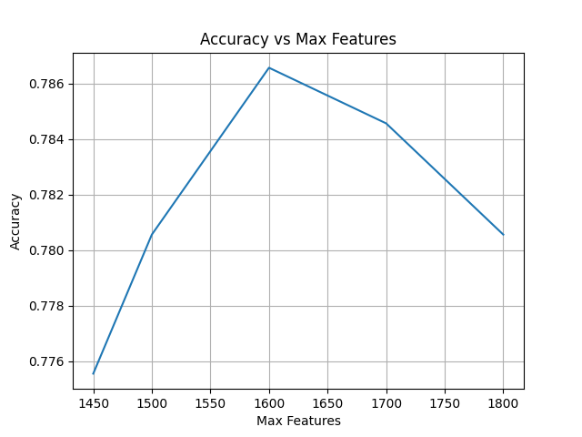
Tuning Parameter Max Features

Slide 15
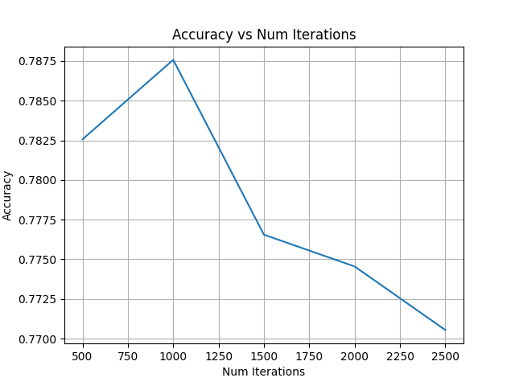
Tuning Parameter Num iterations

Slide 16
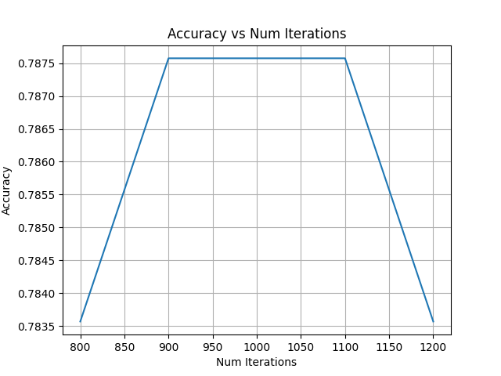
Tuning Parameter Num iterations

Slide 17
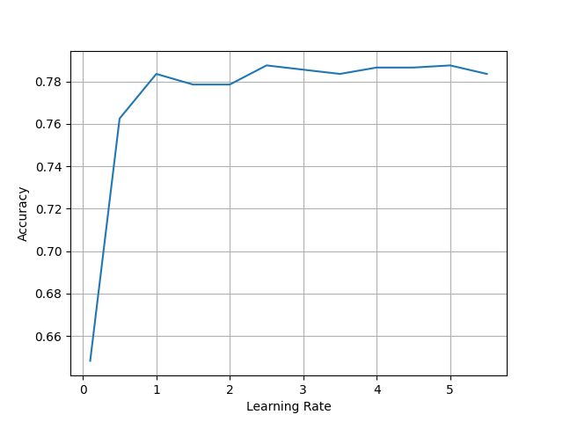
Tuning Parameter Learning Rate

Slide 18
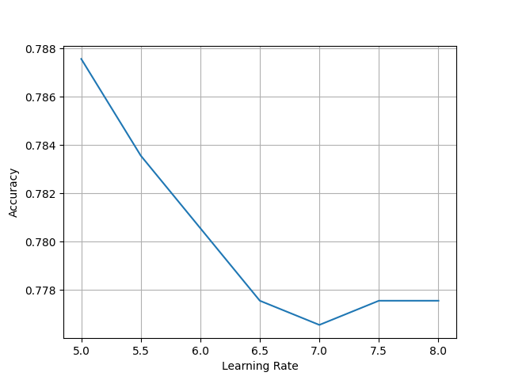
Tuning Parameter Learning Rate

Slide 19

Conclusion
max features = 1600
learning rate = 5
num iterations = 1000
accacuracy ≈ 0.787

